Slide 1
Shadow Caster Culling For Efficient Shadow Mapping
Jiří BittneR¹ Oliver Mattausch²
Ari SilveNnoinen³ Michael Wimmer²
¹Czech Technical University in Prague
²Vienna University of Technology
³UMBRA SOFTWARE

Slide 2
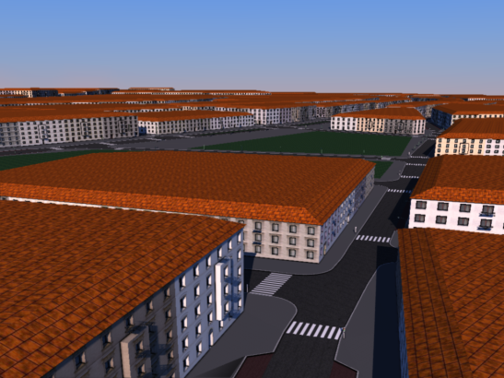
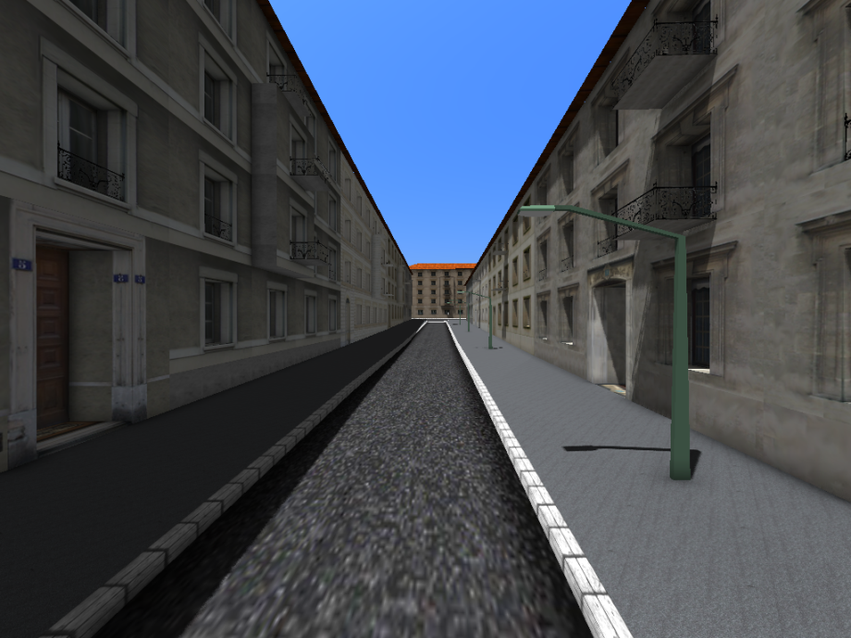
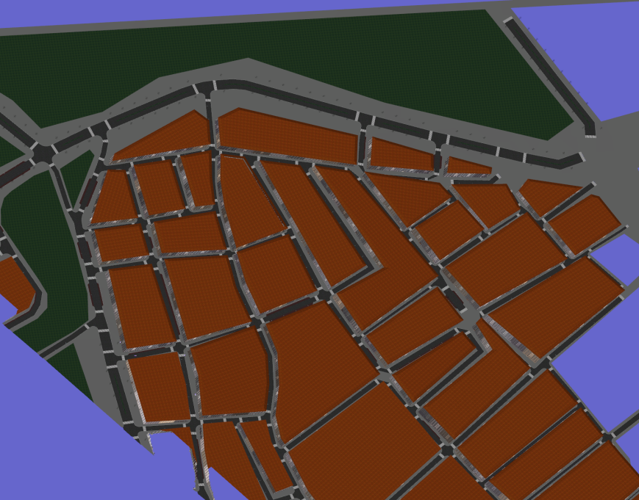
Shadow Caster Culling - Motivation
Camera view
Light view
Occlusion culling 100 FPS
View frustum culling 10 FPS
View frustum culling 10 FPS
Occlusion culling 9FPS
100 FPS
Total 8 FPS
50 FPS
Total 9 FPS
Total 5 FPS

Slide 3
Previous Work
Culling shadow casters for shadow volumes
  Shadow caster culling [Govindaraju et al. 2003]
  CC Shadow Volumes [Lloyd et al. 2004]
  N-Buffers [Decoret2005]
  And others… [Eisenmann&Decoret2006], [Engelhardt&Dachsbacher2009]
Common to all methods
  Shadow map as a proxy (not a bottleneck)
  No culling or simple culling for shadow map
  Analyze the map (cull shadow casters) & render shadow volumes
Shadow mapping
  Higher rendering efficiency than shadow volumes
  Bottleneck moves to shadow map rendering

Slide 4
Shadow Caster Culling - Overview
1. Render camera view
  Occlusion culling, CHC++ [Mattausch et al. 2008]
  Depth map + visible objects
2. Create receiver mask
  Information about visible objects/pixels from camera to light view
  Stencil buffer
3. Render shadow map
  Occlusion queries with stencil test
4. Do shading
  Use shadow map(s) to illuminate camera view
more lights

Slide 5
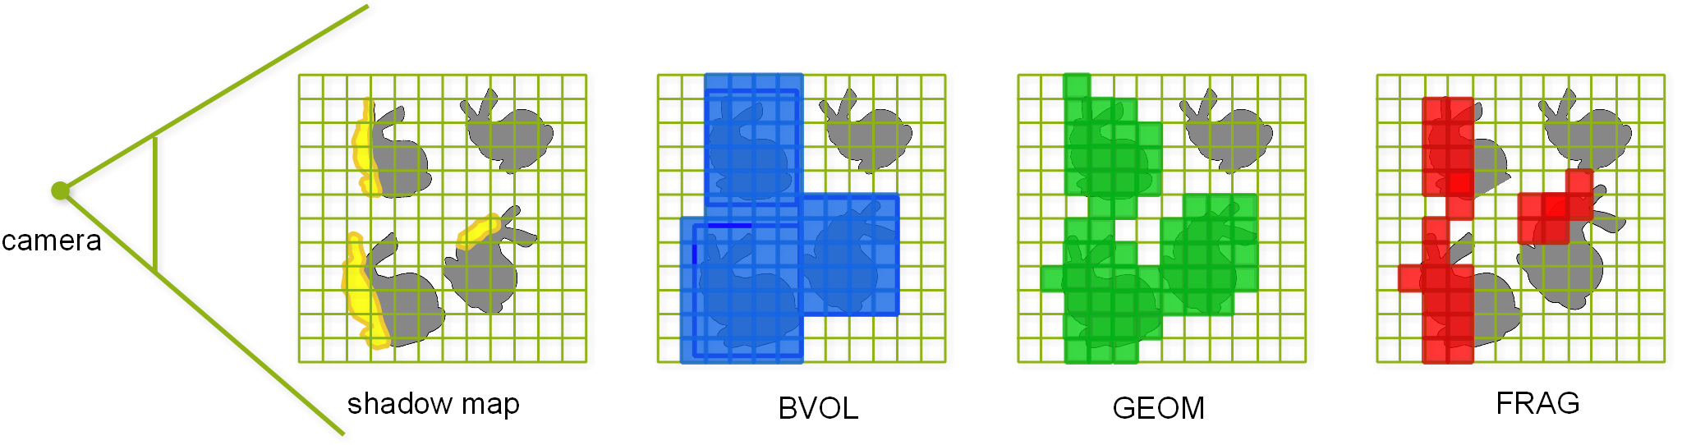
Shadow Receiver Mask
Different ways how to create a receiver mask
  Mask construction cost vs accuracy (culling effciency)
Proposed techniques
  Bounding volume mask (BVOL)
  Geometry mask (GEOM)
  Combined bounding volume & geometry mask
  Fragment mask (FRAG)

Slide 6
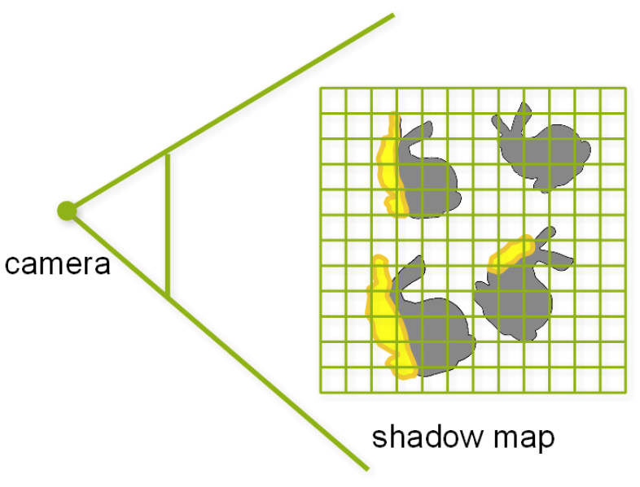
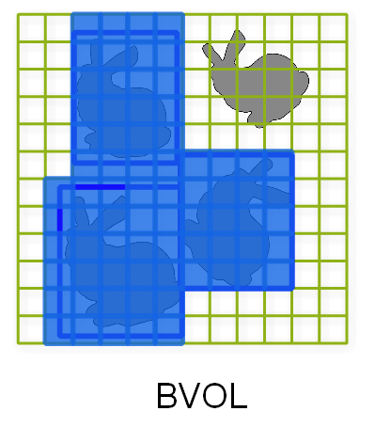
Bounding Volume Mask
Bounding boxes of visible objects to stencil buffer
Fast to render +
Conservative -

Slide 7
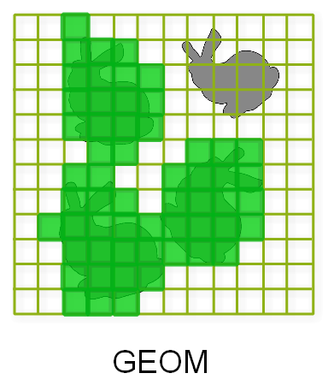
Geometry Mask
Geometry of visible objects to stencil buffer
More accurate +
Possibly slow -
  Fill rate increase (rendering geometry of shadowed receivers)

Slide 8
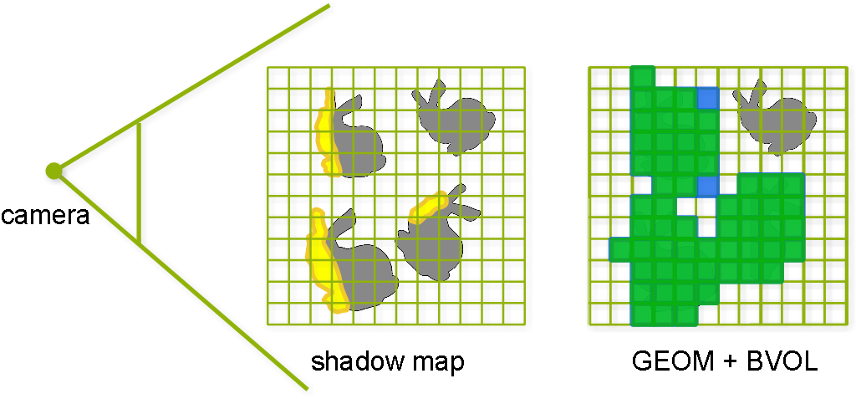
Bounding Volume + Geometry Mask
Geometry for visible objects (from light)
Bounding volumes for invisible objects (from light)
Use temporal coherence
  Predict object visibility based on last frame visibility
Accurate as geometry + Faster than geometry +

Slide 9
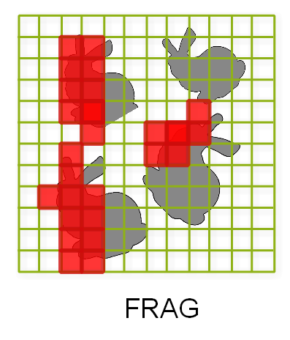
Fragment Mask
Test visibility of fragments in camera view
  “Shadow test” with respect to camera depth map
  [Lloyd et al. 2004], [Decoret2005]
Pixel accurate mask + Slower construction -

Slide 10
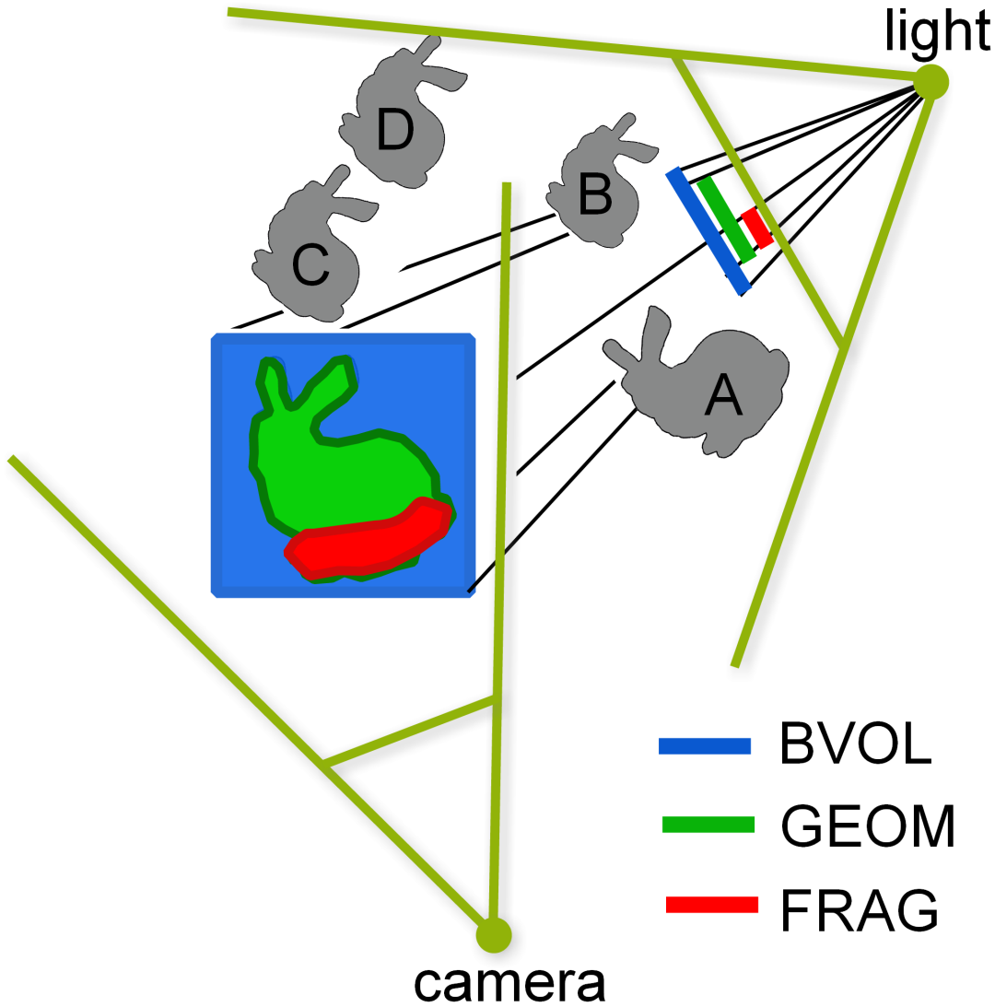
Masks Efficiency Example
Culled
D, C
D, C
D, C, B

Slide 11
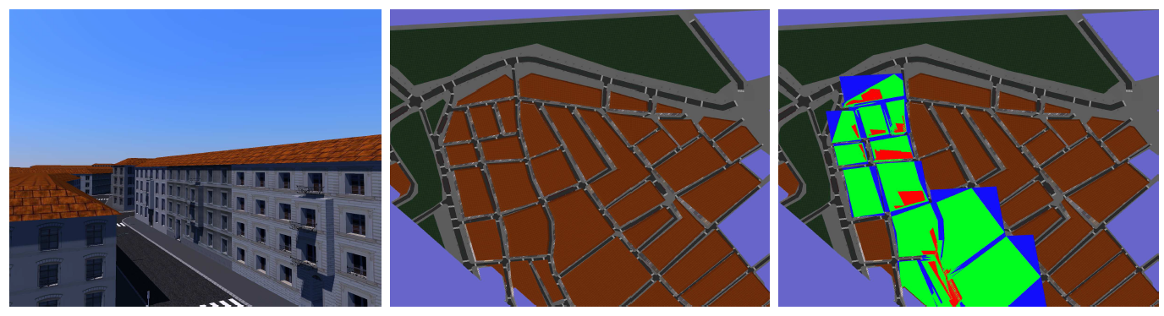
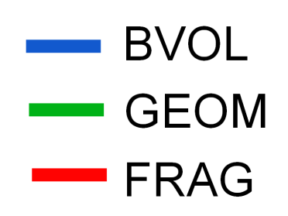
Masks Efficiency Example

Slide 12
Additional Techniques
Visibility-based focusing
Incremental updates for dynamic scenes

Slide 13
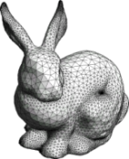
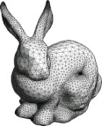

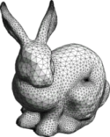
Visibility-based focusing
Focus light frustum on intersection of
view frustum + convex hull of visible objects
Speedup, better use of resolution
Temporal aliasing
Similar to [Lauritzen et al. 2010]
Frame 3
Frame 4
Frame 2
Frame 1

Slide 14
Incremental Updates for Dynamic Scenes
Until now we allowed
  Dynamic scenes
  Dynamic shadows
→ Further optimization possible!
Update only necessary part of shadow map
Construct mask only from visible dynamic objects
  Previous and new position
  Clear depth buffer + write stencil (mask)
Assume static shadow map

Slide 15
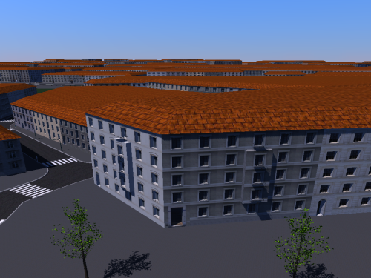
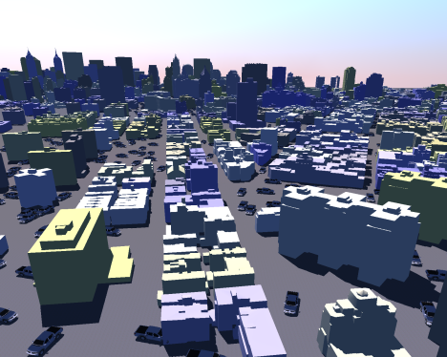
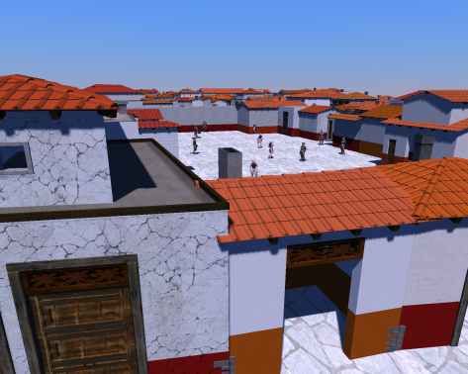
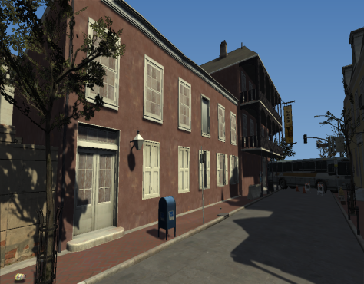
Results
Reference methods
  VFC - view frustum culling (camera + light)
  REF - CHC++ occlusion culling (camera + light)
  FOCUS - REF + visibility-aware focusing
Uniform/Light space perspective shadow maps (LiSPSM)
Intel Core i7-920 2.67 GHz + GeForce 480 GTX
Vienna
12M vert.
Manhattan
105M vert.
Pompeii
63M vert.
Left4Death2
1,5M vert.

Slide 16
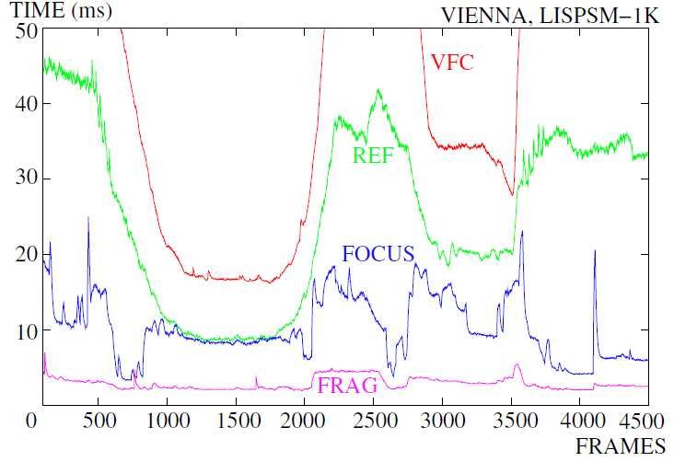
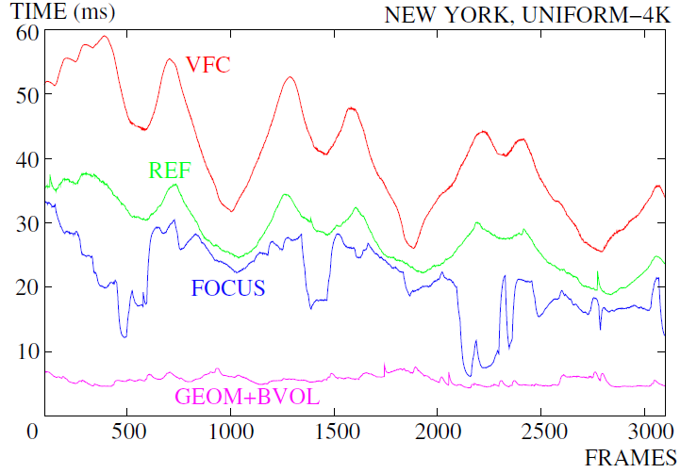
Walkthrough Timings

Slide 17
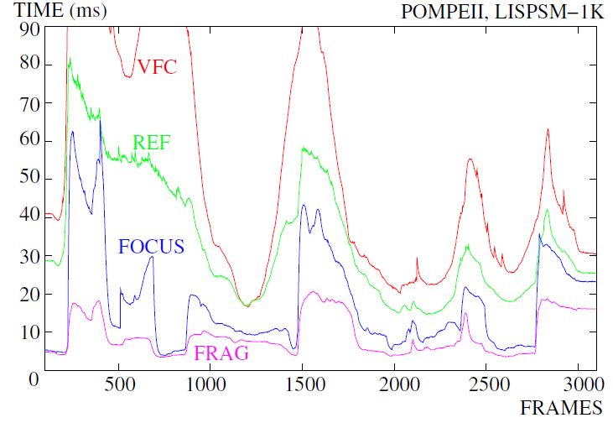
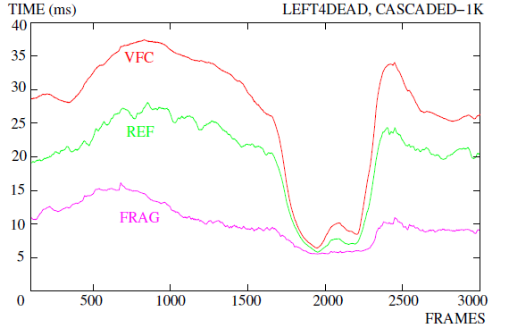
Walkthrough Timings

Slide 18
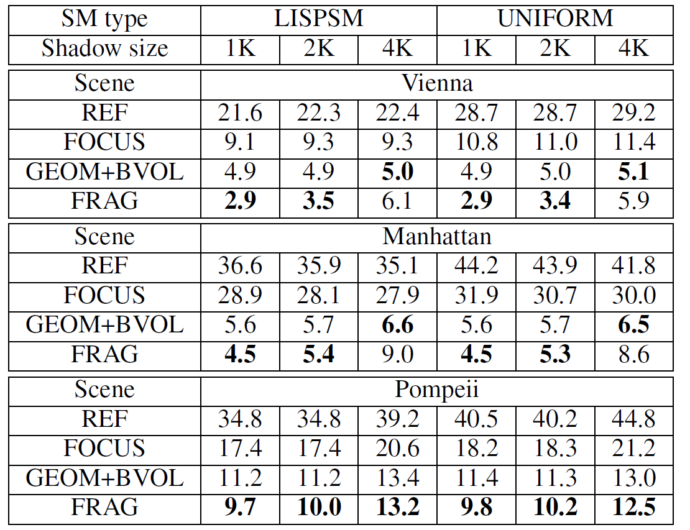
Walkthrough Summary Results
Average frame times [ms]

Slide 19
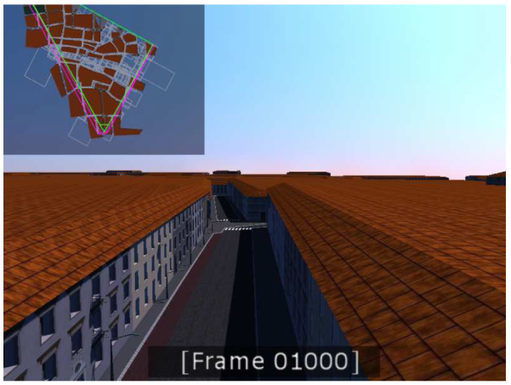
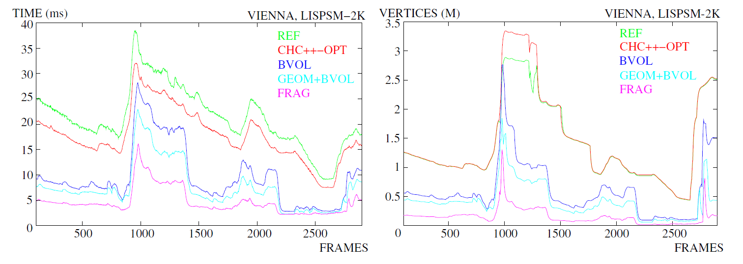
Different Masking Techniques

Slide 20
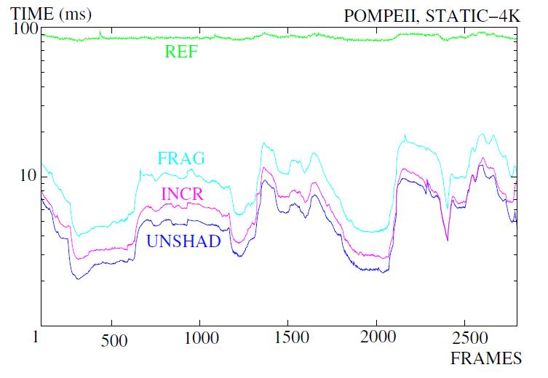
Incremental Updates
UNSHAD – no shadow mapping

Slide 21
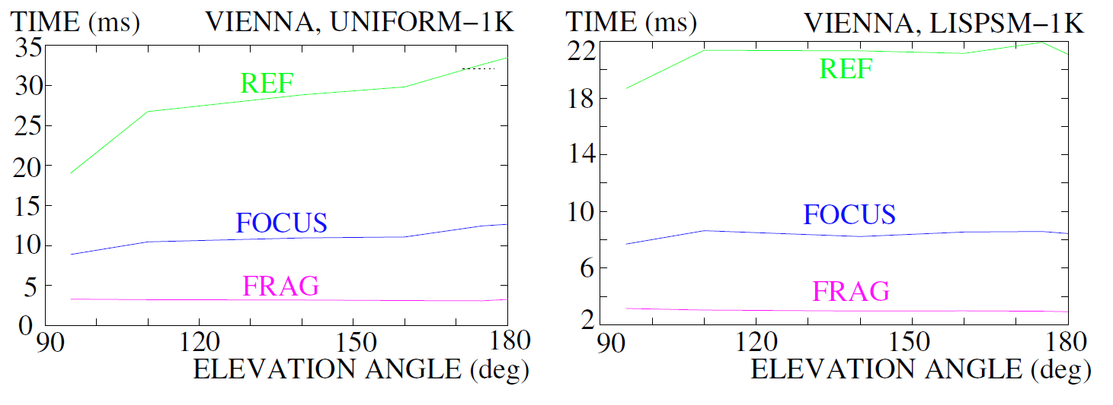
Light Elevation Angle

Slide 22
Conclusion & Future Work
Efficient shadow map rendering method
  Shadow receiver mask
  Mask culling + occlusion culling (using extended CHC++ algorithm)
  Different masks
  Incremental updates
Results
  3-10x faster than traditional culling for large city scenes
  1.5-2x faster for game scene
  Implemented inside visibility middleware (Umbra Software)
Future Work
  More light sources
  Incremental updates for moving lights

Slide 23
… thank you
bittner@fel.cvut.cz

Slide 24
… thank you
bittner@fel.cvut.cz

