Slide 1
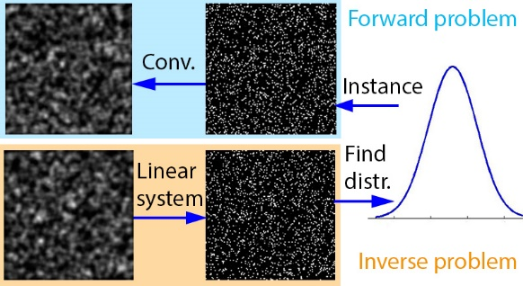
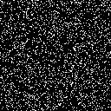
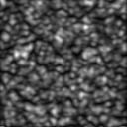

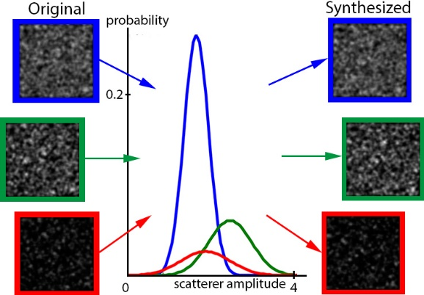
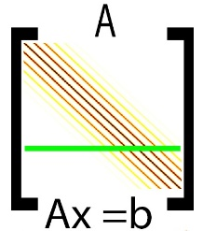
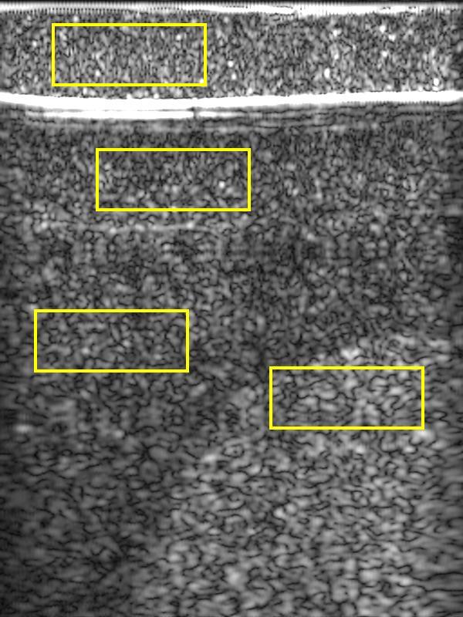
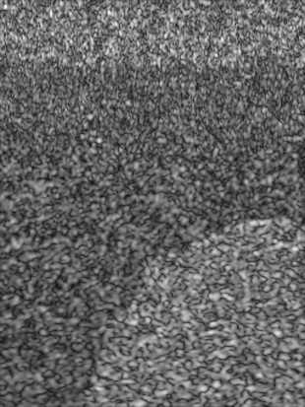


SCATTERER RECONSTRUCTION AND
PARAMETRIZATION OF HOMOGENEOUS TISSUE
FOR ULTRASOUND IMAGE SIMULATION
Oliver Mattausch and Orcun Goksel
Ultrasound simulation (forward problem)
  Important for training of sonographers
  Characteristic ultrasound tissue (i.e., speckles) due to scattering with microscopic (unobservable) reflectors
  Scatterers often modelled using parametrization [Bürger13]
  Realistic and efficient speckle simulation due to convolution of parametrized scatterer image with US point-spread function
Simulation pipeline
  Reconstruct scatterer image for homogenous patch of tissue
  Estimate scatterer density and distribution N(µ,σ) of amplitude values from reconstructed scatterers
  Instantiate new scatterers to fill arbitrary volume
  Plug instantiated scatterers into forward simulation pipeline
*
=
PSF
scatterer image
speckle image
[Bürger13] B. Bürger, S. Bettinghausen, Radle M., and J. Hesser. Real-time gpu-based ultrasound simulation using deformable mesh models. IEEE Trans. Med. Imaging, 32(3):609–618, 2013.
Tissue reconstruction and simulation results
Our method (inverse problem)
  Open problem: How to find distribution of scatterer values which creates a given image of ultrasound tissue?
  Scatterer representation allows simulation of tissue with arbitrary US parameters
  Problem can be expressed as linear system with convolution matrix A, solving for scatterer image x
  Scatterers typically assumed to be sparse and pointlike →
  we formulate system as L₁ total variational regularization
  Solve system using convex optimization
Computer phantom
x
b
estimated
parametrization
scatterer image
resolution 128²
Pelvic phantom (using 3 tissue samples)
scatterer image
convolution matrix
speckle image
arg min.
s.t. x≥0
Original
scatterer image
resolution 2156x256
Synthesized

Slide 2


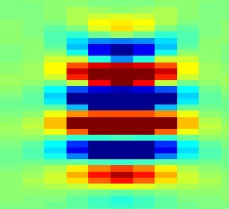
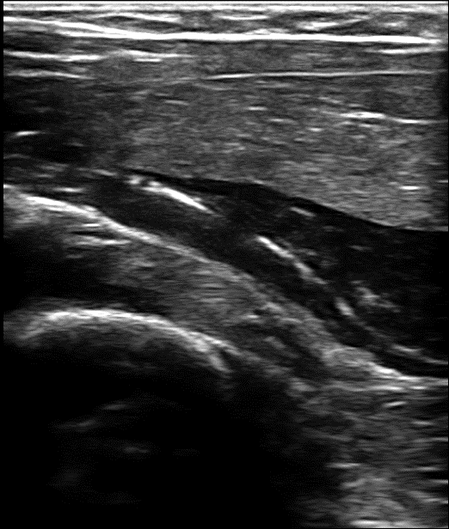

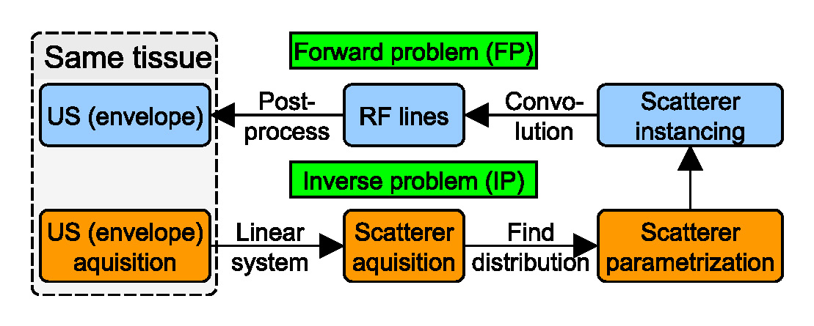
Future work
  Use in actual 3D ultrasound simulation (currently only 2D)
  Quantitative evaluation of simulated results
Ultrasound speckles

