Slide 1
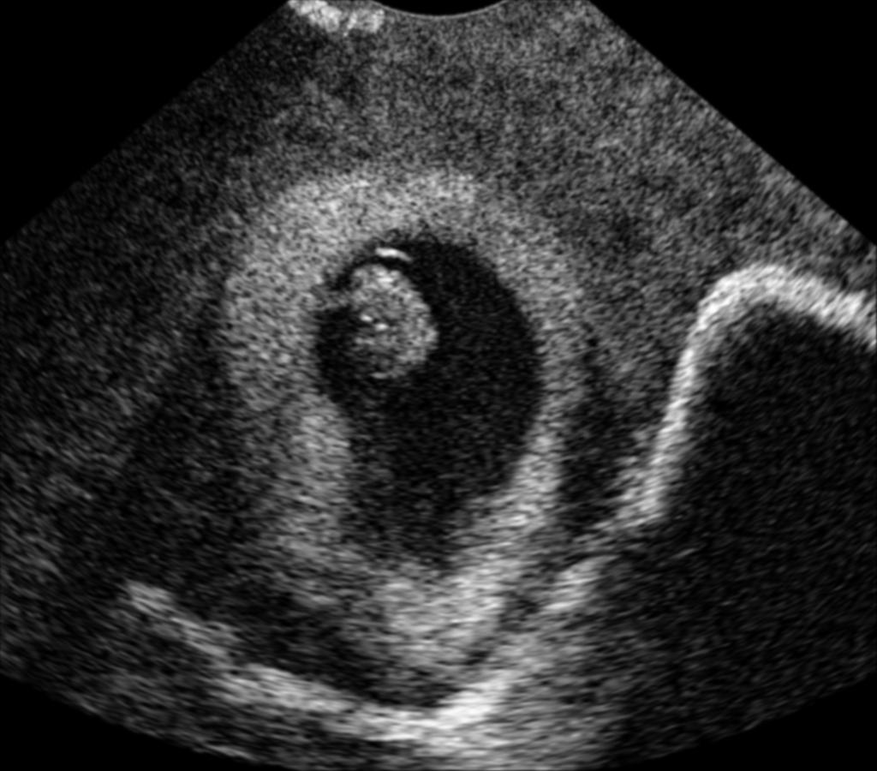
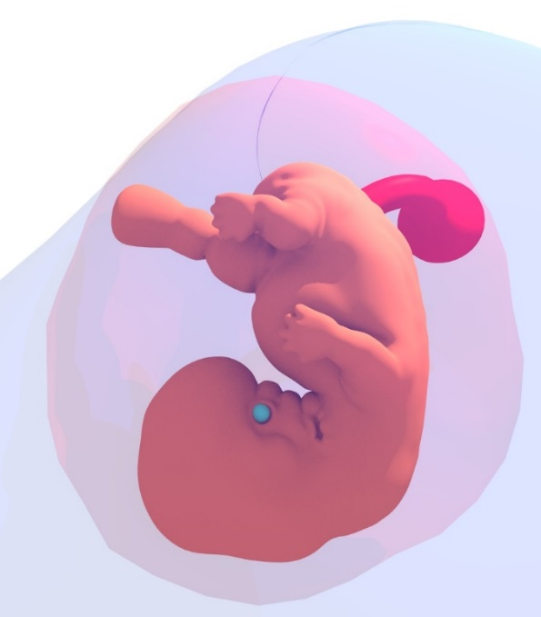
Monte-Carlo Ray-Tracing for Realistic Interactive Ultrasound Simulation
Oliver Mattausch, Orcun Goksel
Computer-assisted Applications in Medicine (CAiM)

Slide 2
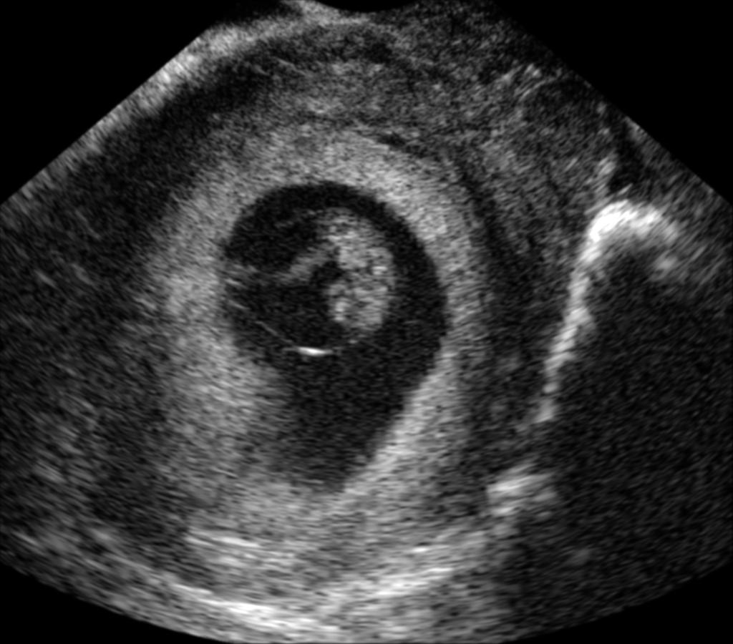
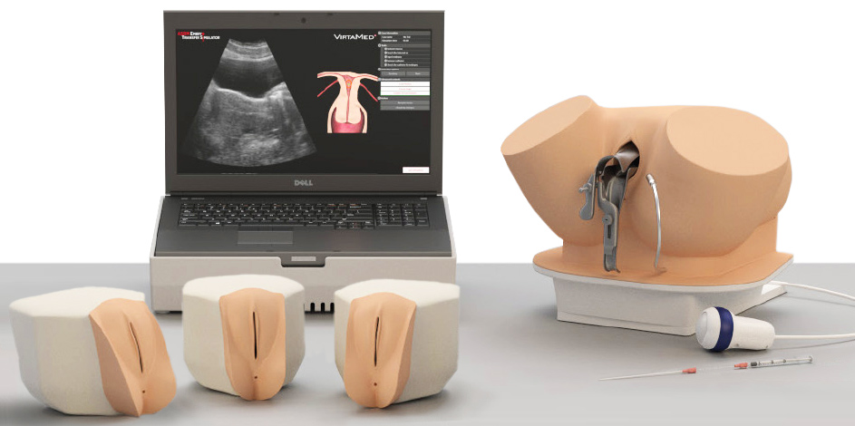
Ultrasound (US) Simulation for Training
Ultrasound: radiation-free, low-cost, real-time
Low SNR + ultrasound artifacts require training
Training difficult, e.g., of rare pathologies
Few volunteers for transvaginal, transrectal, biopsy
Huge potential for interactive VR simulator
Goal: plausible simulation for experts
US image of pregnancy
Notes:
Remove lines in template
Motivation: Transvaginal, transrectal ultrasound, biopsy (no volunteers)

Slide 3
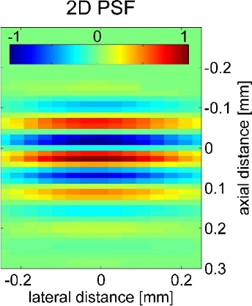
Ultrasound Image Generation
single element receiving echo,
creating radio-frequency (RF) line
transducer elements
(128-256 crystals)
many element transmitting
beamformed
point-spread function
beam forming
due to negative/positive interference

Slide 4
Ultrasound Image Generation
Reflections
interactions with large-scale structures (≫wavelength)
dictated by Snell’s law
Ultrasound artifacts
e.g., shadows due to beam refractions
Ultrasound speckle
interactions with microscopic structures (<wavelength)
act like point scatterers
US image of pregnancy
Notes:
3 things are important for a realistic ultrasound image.
Specify terms: speckles, reflections, ultrasound artifacts
Explain accustic impedance differences as us propagates, if objects larger than wavelength, they act like point scatterers

Slide 5
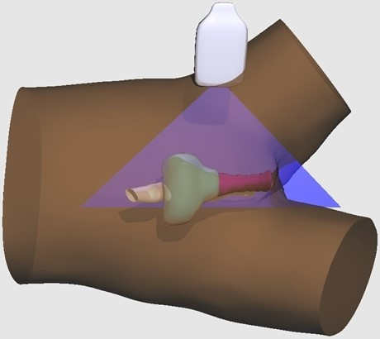
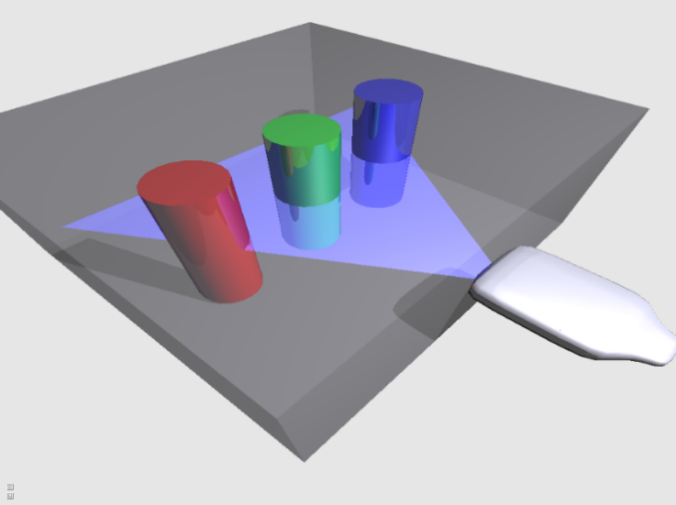
Raytracing-Based Ultrasound Simulation
Handles large-scale interactions
Input:
  CT image [Salehi et al. MICCAI15]
  Triangle model [Bürger et al. TMI13] (most flexible)
artificial phantom
human anatomy model

Slide 6

Raytracing-Based Ultrasound Simulation
Binary deterministic raytracing [Whitted80]
shoot ray/RF line
Snell’s law
(ratio of impedances)
Problems:
exponential complexity
poor parallelism on GPU
reflection
tissue 1
refraction
tissue 2
tissue 3
Notes:
These methods use deterministic ray tracing, also known as Whitted Raytracing in the CG community.

Slide 7
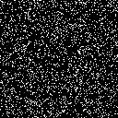
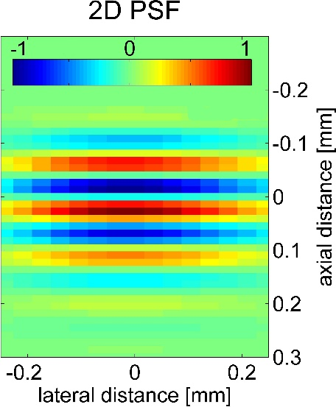
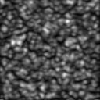
Convolution-Based Ultrasound Simulation
Handles small-scale interactions
Linear approximation of full wave interactions [Karamalis10, Jensen04]
Fast separable convolution on GPU: COLE [Gao et al. TUFFC09]
=
*
tissue representation
(scatterer map)
convolution
ultrasound speckle

Slide 8
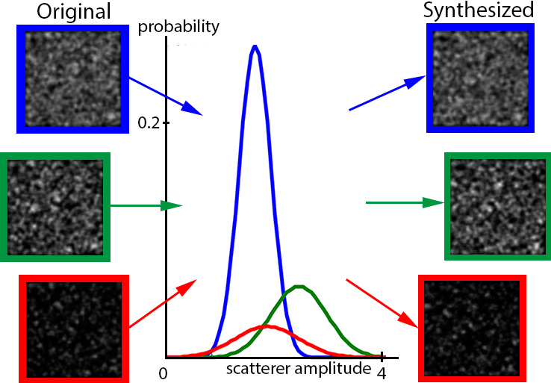
Convolution-based Ultrasound Simulation: Tissue Model
3-parameter tissue model (μ, σ, ρ)
after convolution with PSF
(ρ)
tissue representation
(μ, σ)
values can be automatically derived from images [Mattausch and Goksel EMBC15]
Notes:
Left side afterwards, in references conference name first
Rho: probability of non-zero pixel value

Slide 9
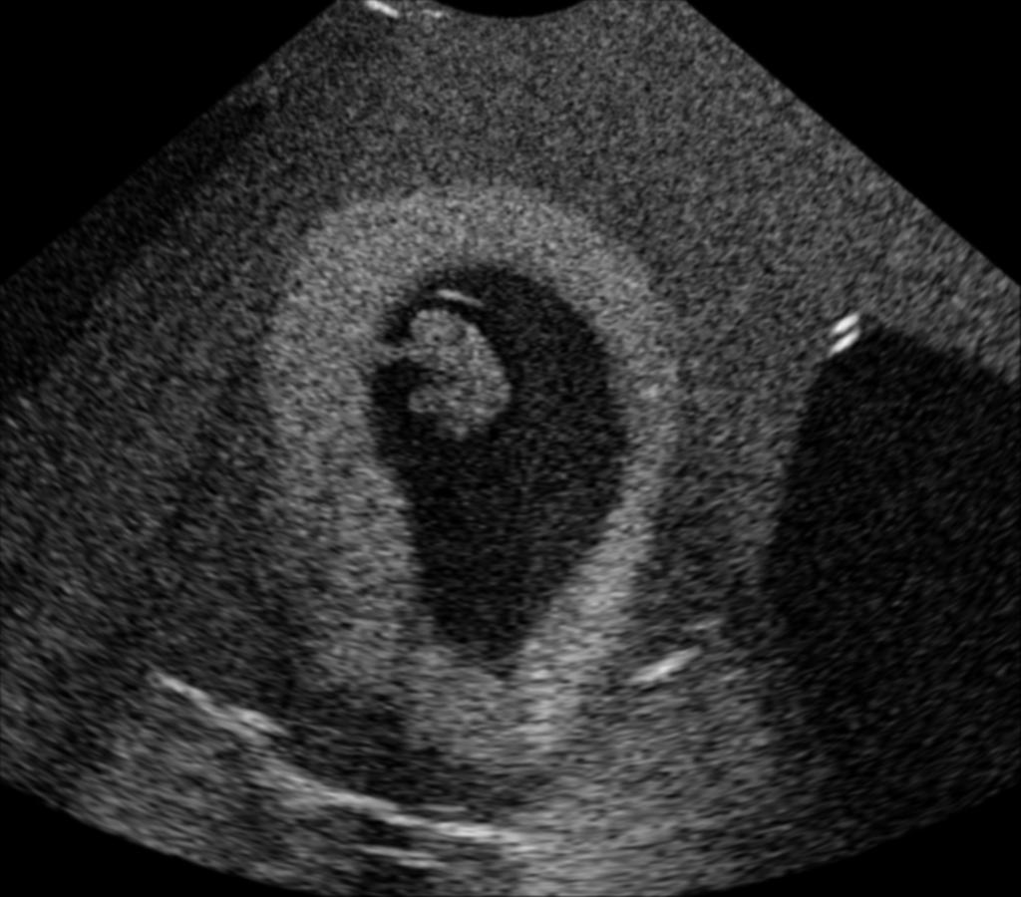
State of the Art: Issues
Deterministic model: Infinitely thin perfectly specular surfaces
3-parameter tissue model: uniform (toy-like) speckle
in-vivo
pregnancy
deterministic raytracing
+ convolution
Notes:
Comparing the state-of-the art simulation with an actual pregnancy, several issues become apparent.
Add snells law
Orthogonal reflections show up

Slide 10
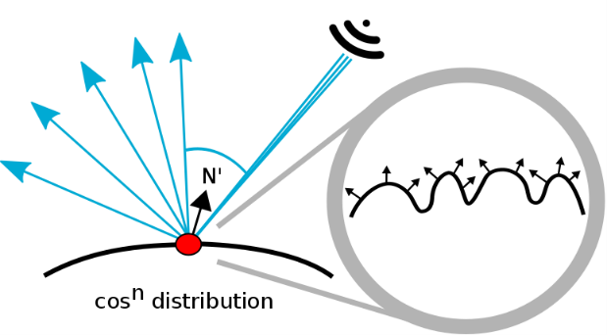
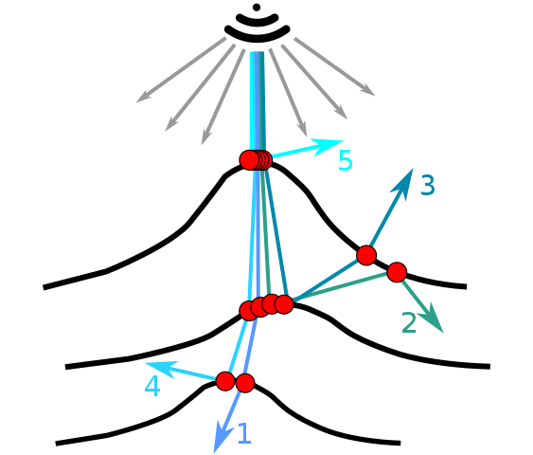
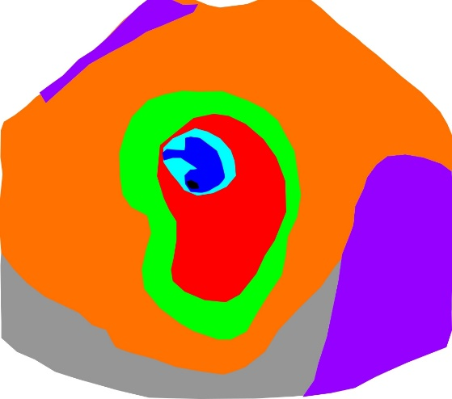
Our Contributions
Improved surface model
Efficient evaluation using Monte-Carlo raytracing
Improved volumetric tissue model

Slide 11
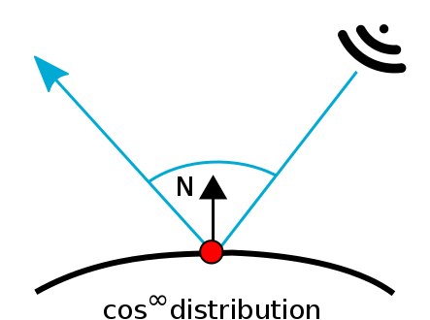
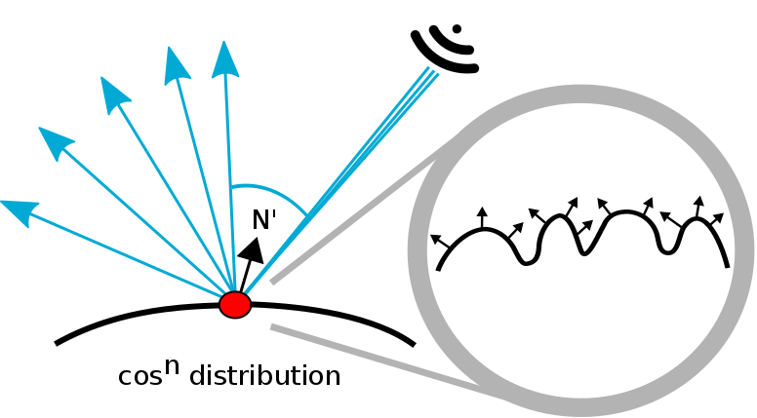
Improved Surface Model: Roughness
specular surface model
surface roughness model
Notes:
In contrast to the perfectly specular surfaces of previous approaches, we propose that real surfaces have imperfections, causing the surface normal to wiggle wrt. a cosine distribution, where n models the surface roughness.
Snell’s law, not cos infinity before defining model, put profile here of cos distribution

Slide 12
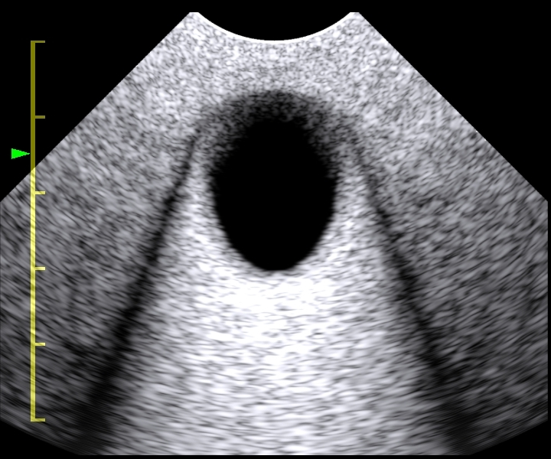
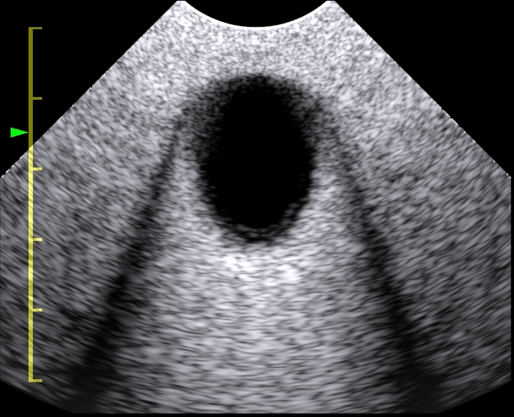
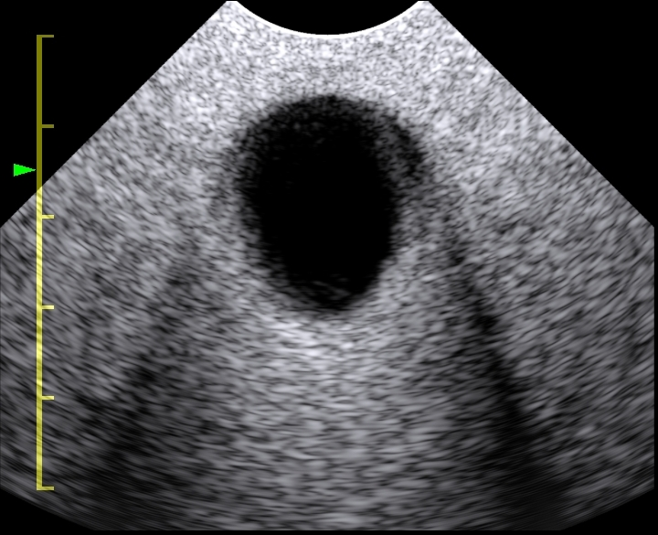
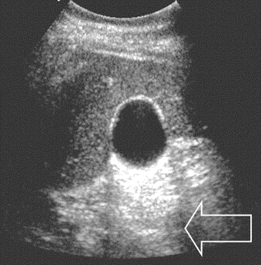
Improved Surface Model: Roughness
fluid-filled spherical object
cos∞ distr.
cos¹⁰⁰ distr.
cos¹⁰ distr.
hypoechoic ‘whiskers’
due to refractions
in-vivo
example
Notes:
To show the possibilities of the surface roughness model, a simulation of a fluid-filled spherical object is used.
Increasing the surface roughness causes the shadow softness to increase.
In practice, this parameter has to be adjusted to fit a target appearance.
As comparison, this is an-vivo example.
explain how a typical sphere artifact should look like (basically the hyopechoic "whiskers" behind small angle surface due to refraction bending the rays and "shadowing" those area). You can may be show a sample example image with bladder or a cyst, highlighting those shadows. Also, motivate the importance of showing those shadows correctly, by mentioning that the (whisker) shadows are important for the doctor to infer the content of (diagnose) inclusions from their acoustic impedance difference.

Slide 13
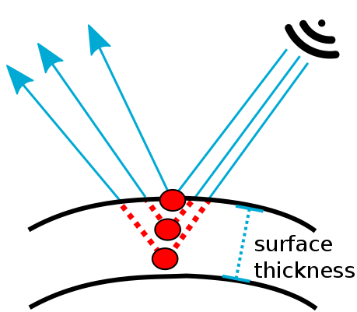
Improved Surface Model: Thickness
flat surface model
surface thickness model
Notes:
Hence, in contrast to the infinitely flat surfaces of previous approaches, we propose that real surfaces have finite surface thickness, allowing a ray to penetrate further into a tissue wrt. to a surface thickness parameter.

Slide 14
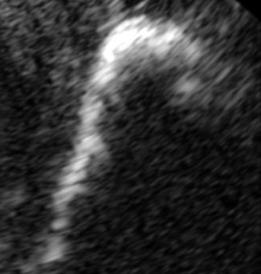
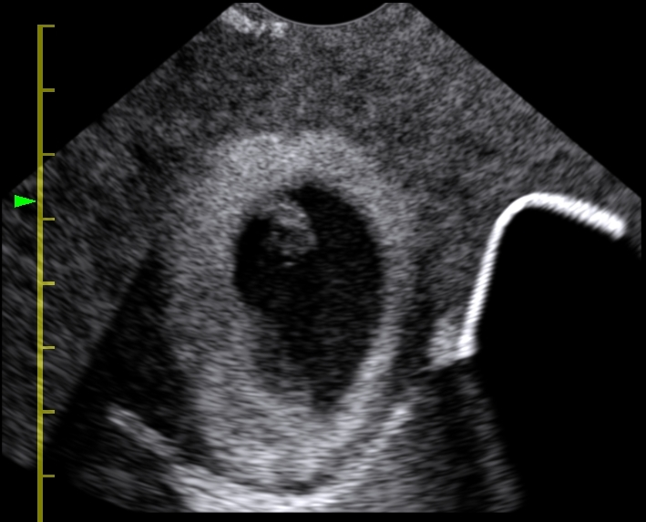
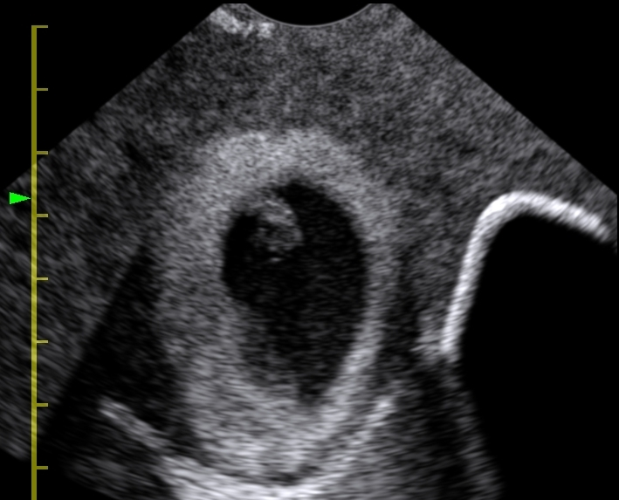
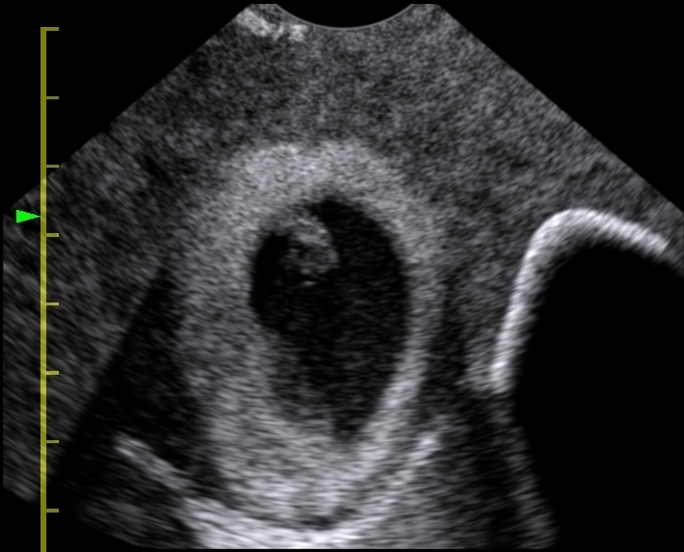
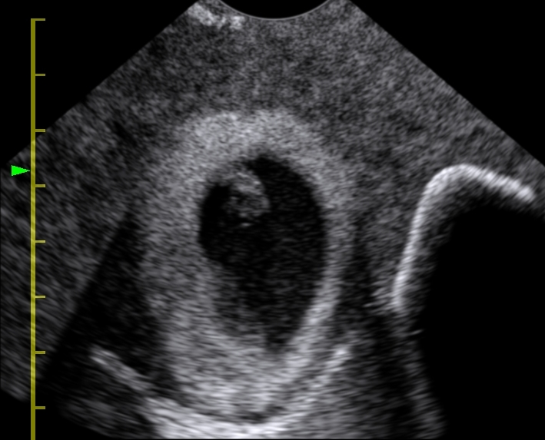
Improved Surface Model: (Bone) Thickness
in-vivo bone image
0mm
3mm
6mm
9mm
Notes:
In the first image, the bone structure is generated with zero thickness, looking artificial and lacking similarity to an actual bone image.
put the actual US image, perhaps on the left or right of all images (with same areas that you indicate marked/circled) as a ground-truth and visual comparison from the slide start

Slide 15
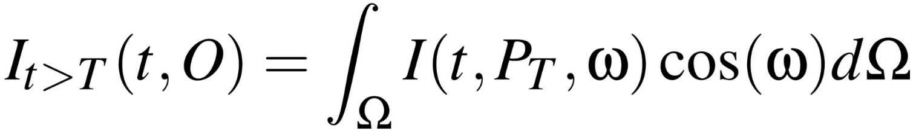
Efficient evaluation using Monte-Carlo Raytracing
US signal after surface intersection P_{T}
Intractable for deterministic methods
stochastic ray paths
P_{T}
integrate
over
hemisphere
recursive
formulation
linear complexity
easily parallelizable
Notes:
Next, I show how to solve our surface model efficiently.

Slide 16
Monte-Carlo Raytracing
transducer elements
d
reduce path
contribution wrt. d
Snell’s law gives
centerline of beam
beam forming
path weighting

Slide 17
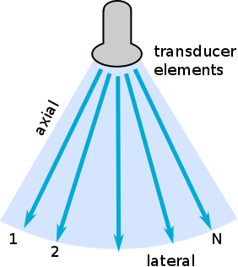
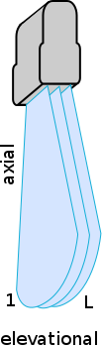
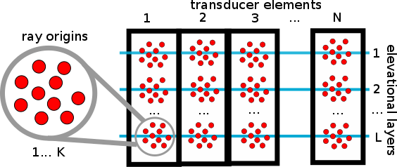
Monte-Carlo Raytracing: Initialization
image plane
finite transducer thickness
perturbed ray origins
Notes:
In the simplest version, a ray is generated per element, equally sampling the image plane.

Slide 18
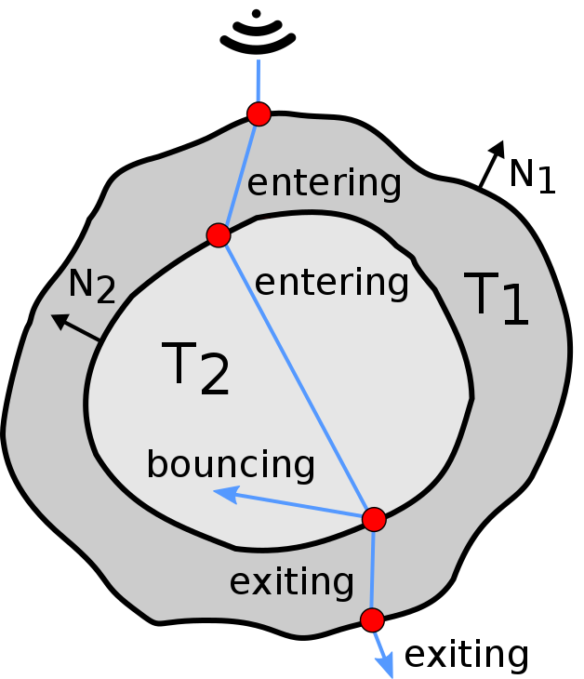


Improved Volumetric Tissue Model
cross-section of model on image plane
periphery
gestational
sac
bone
reflecting tissue
rasterize ray segment
wrt. tissue parameters
stack-based approach
to identify tissue T
Notes:
Ultrasound imaging records a slice of the model in the image plane.

Slide 19
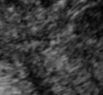
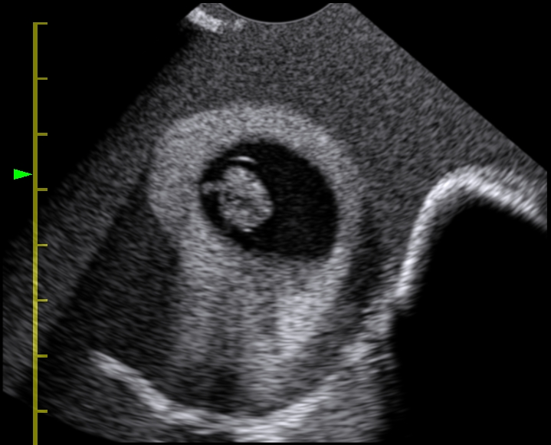
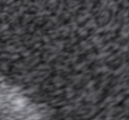
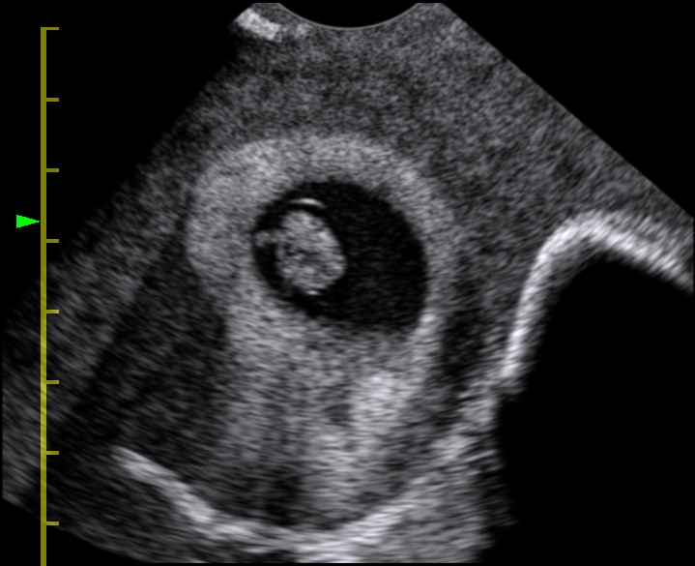
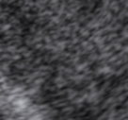
Improved Volumetric Tissue Model
Small-scale variations: μ, σ, ρ
Large-scale variations: magnitude A_{l}, frequency f_{l}
Implement with high- and low-res 3D noise texture
in-vivo tissue
too uniform
more natural
3-parameter model
improved model
Notes:
Our improved tissue model has 5 parameters, the 3 known ones describing small scale variations, and 2 new parameters describing the magnitude and frequency of large-scale variations.
motivation and justification of large scale variations making things look more real was not convincing (also considering that the audience may not appreciate what is a more-real US image). I suggest to point out the homogeneous look of the former method, and say "as you might imagine the anatomy does not look such homogenous and almost like a toy-image" and then mention the larger-scale as "approximating larger scale anatomical variations, giving a realistic organ appearance".

Slide 20
Results
Implementation: C++ using Nvidia Optix and CUDA 7.0
GPU: NVIDIA GTX 780Ti with 3GB
Pregnancy scene | 255K triangles
Image depth | 8.1cm
Transducer frequency | 7Mhz
Transducer FOV | 99 deg
RF lines | 192
RF depth | 2048
Elevation layers | 5
Notes:
Next, I will show some more results from the pregnancy scene, which were created using the following environment.

Slide 21

Results: Comparison
in-vivo image
input
255K triangles
deterministic
2.8 FPS
Monte-Carlo (40 paths)
1.4 FPS
expert judgement
realism: 2 of 7
expert judgement
realism: 6.5 of 7
Notes:
This is a comparison of previous work and our approach to an in-vivo image.
Note that the embryo is not in the same place in the in-vivo image, since we used a detailed model from a different source,
whereas the rest of the scene was directly segmented from the source.
Since our goal is for our simulation to look plausible for experts, we asked a gynologist for his opinion,
rating the realism of the simulation method on a scale from 1 to 7.
don't say "the embryo may not look *real*". It sounds like we could not achieve our goal. Better to say something like "The embryo may not be at the *same place*, since we used a detailed 3D model of the embryo from a different source, created independently from the US image seen."

Slide 22
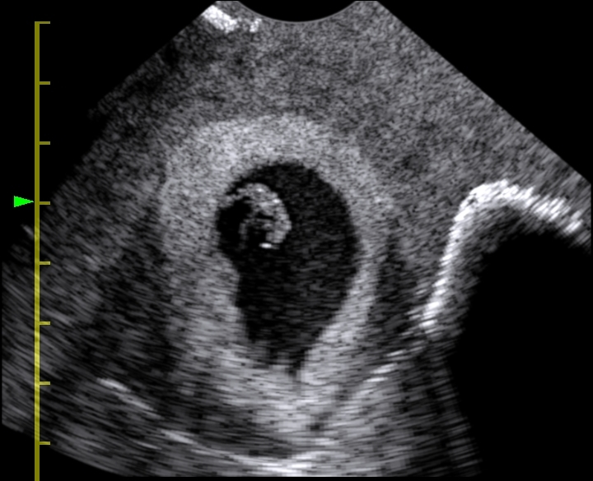
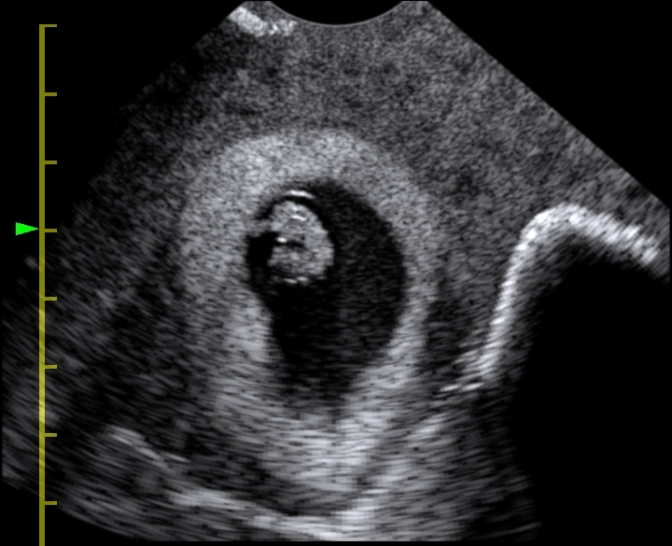
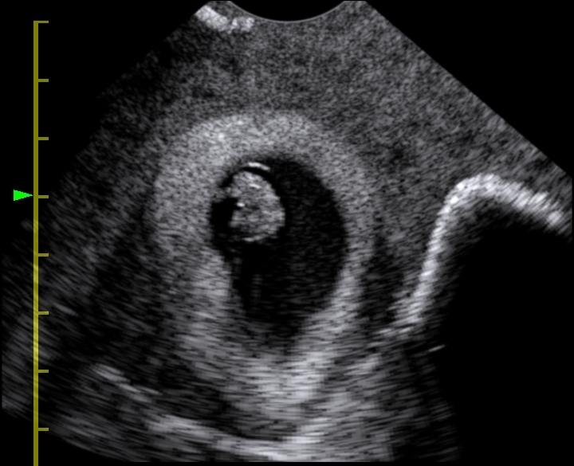
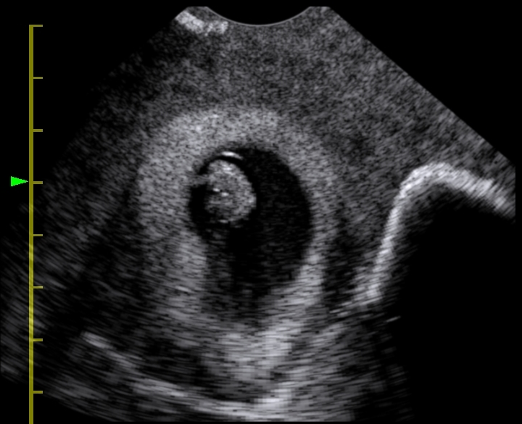
Results: Number of Ray Paths
deterministic raytracing
frame time: 357ms
5 paths
303ms
15K rays/s
15 paths
384ms
37K rays/s
25 paths
476ms
50K rays/s
40 paths
714ms
54K rays/s
Notes:
This side shows the influence of the number of ray paths on performance and image quality.

Slide 23
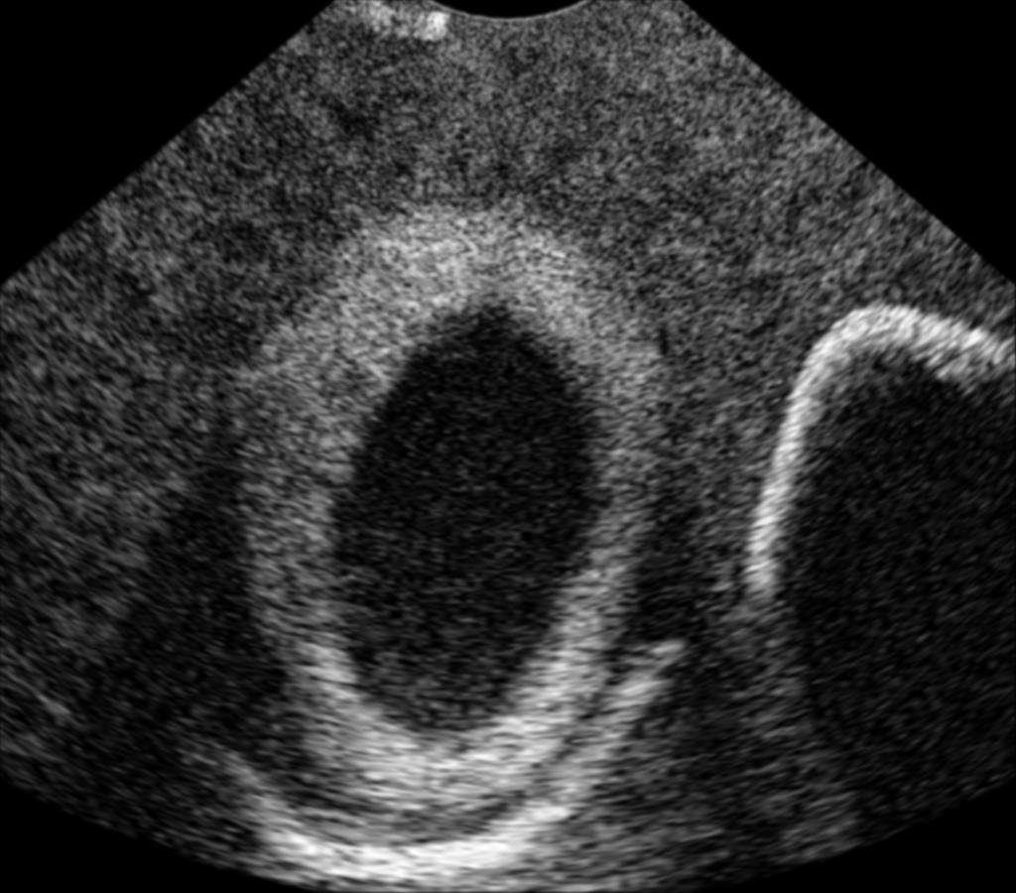
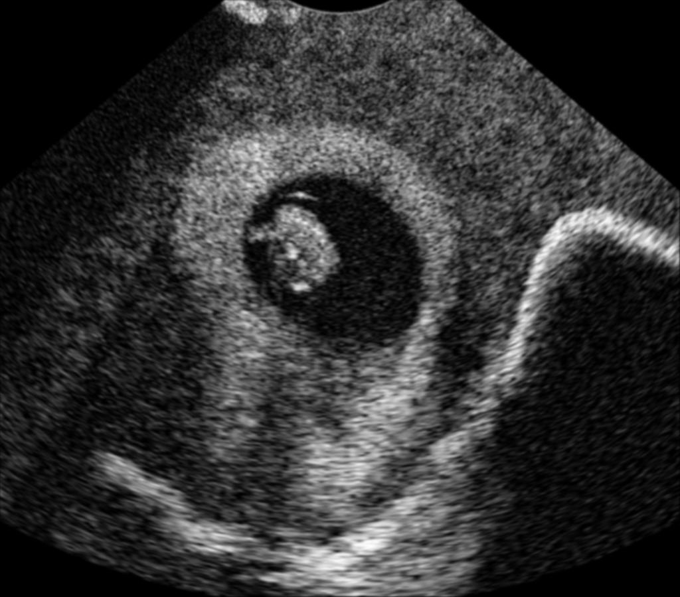
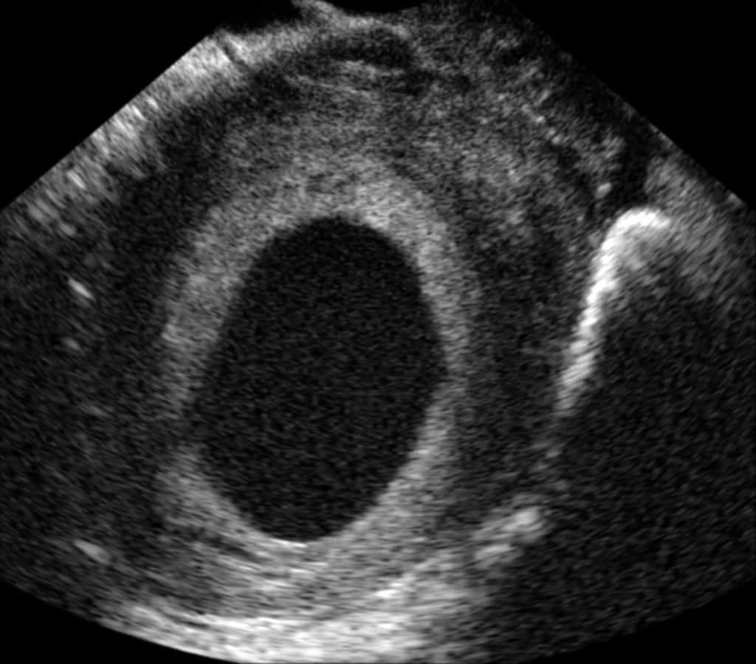
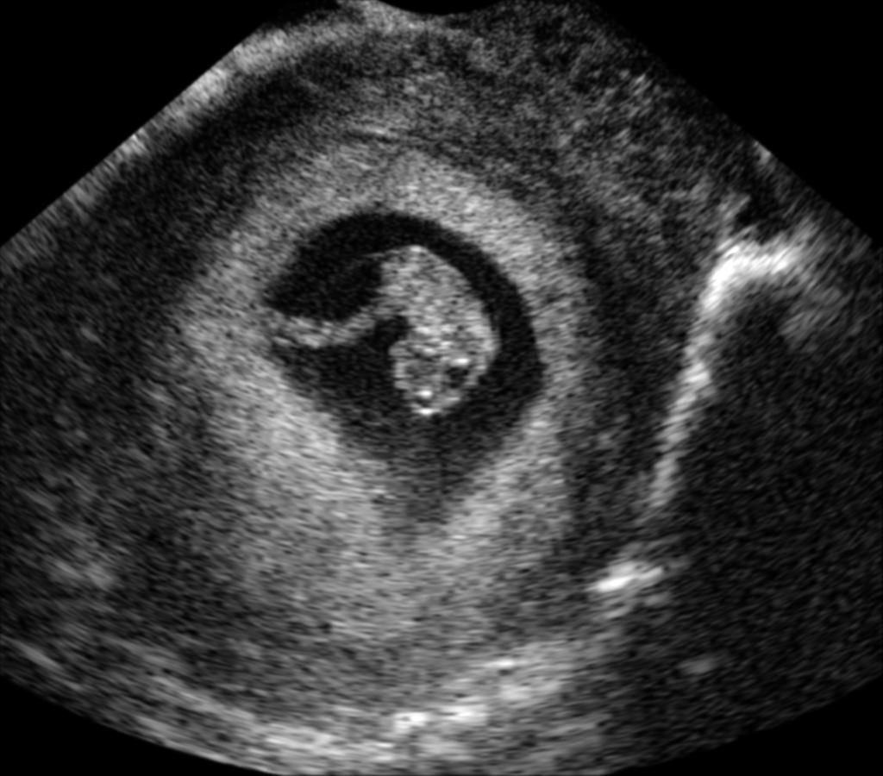
Thank you for your attention!
simulated image
in-vivo image
This work was sponsored by the Swiss Commission for Technology and Innovation (CTI).
Notes:
At last, I would like to show you some additional slices of the pregnancy scene simulated with our method and compare it to in-vivo images.

Slide 24
Frame time wrt. max. recursion level
Max. Recursions | Deterministic | MC 15 rays | MC 25 rays | MC 40 rays
7 | 233 ms | 392 ms | 472 ms | 705 ms
10 | 299 ms | 384 ms | 471 ms | 709 ms
12 | 357 ms | 384 ms | 476 ms | 714 ms

Slide 25

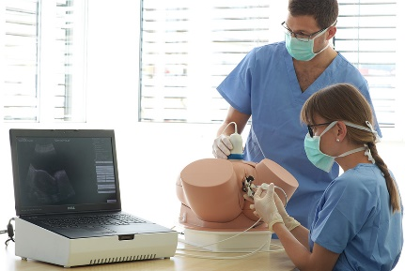
Conclusions
Presented Monte-Carlo method for interactive US simulation
Can be used in training simulators (huge market potential)
Future work: Evaluation of realism in user study

Slide 26
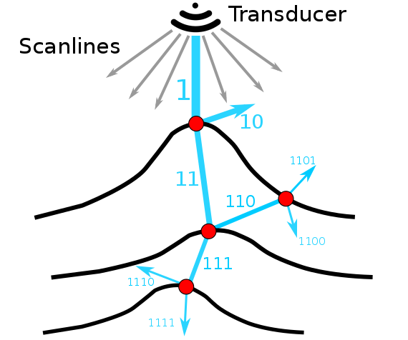
Monte-Carlo ray tracing
binary deterministic ray-tracing
Monte-Carlo ray-tracing

Slide 27
Conclusions
Presented Monte-Carlo method for interactive US simulation
Can be used in training simulators (huge market potential)
Future work: Implement deformation models for animation

Slide 28
Generative Ultrasound Simulation Methods
Wave simulation
(e.g., Westervelt Equation [Karamalis10], FieldII [Jensen04)])
  High-quality simulation
  Not interactive

Slide 29
Ultrasound Simulation Methods
Wave simulation (e.g., Westervelt Equation [Karamalis10], FieldII [Jensen04)])
  High-quality simulation
  Not interactive
Convolution-based methods
  Linear approximation of wave interactions
  Convolution of scattering tissue with beamformed Ultrasound PSF
  Fast separable convolution on grid possible (COLE [Gao09])
  Cannot describe large-scale interactions (reflections, refractions)
Interpolative methods [Aigner01, Goksel09]
  Precomputed ultrasound
  Realistic, fast
  Restrictive (e.g., for rare cases), limited FOV, transducer parameters fixed

Slide 30
Monte-Carlo Ray Tracing
binary deterministic model
Monte-Carlo ray-tracing
reflection
stochastic perturbations
refraction
exponential complexity
linear complexity

Slide 31
Results
Implementation: C++ using Nvidia Optix and CUDA 7.0
GPU: NVIDIA GTX 780Ti with 3GB
Texture Size
RF image size
Elevation Layers

Slide 32
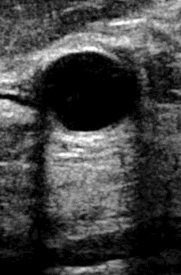
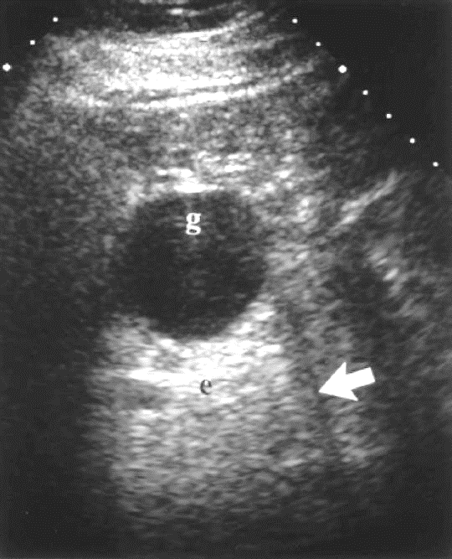
Improved Surface Model: Roughness
in-vivo examples of fluid-filled objects
refractive shadows
Notes:
explain how a typical sphere artifact should look like (basically the hyopechoic "whiskers" behind small angle surface due to refraction bending the rays and "shadowing" those area). You can may be show a sample example image with bladder or a cyst, highlighting those shadows. Also, motivate the importance of showing those shadows correctly, by mentioning that the (whisker) shadows are important for the doctor to infer the content of (diagnose) inclusions from their acoustic impedance difference.

Slide 33
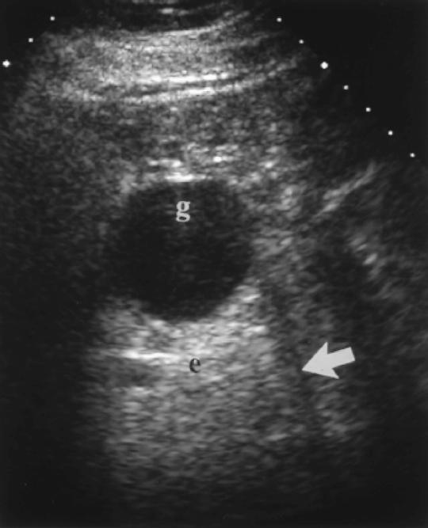




Improved Surface Model (Cyst)

